Slide 1
Quick sort using recursive method
Recursive Algorithm
  Example
Quick sort complexity

Slide 2
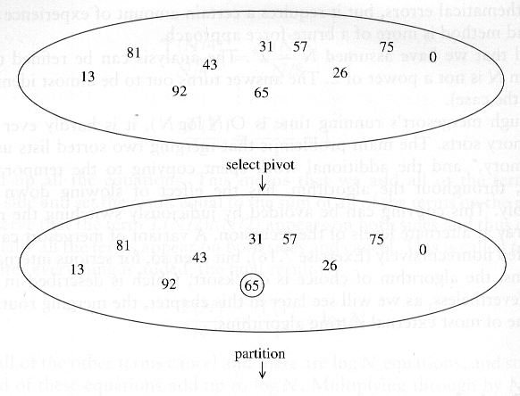
Quick Sort: Example

Slide 3
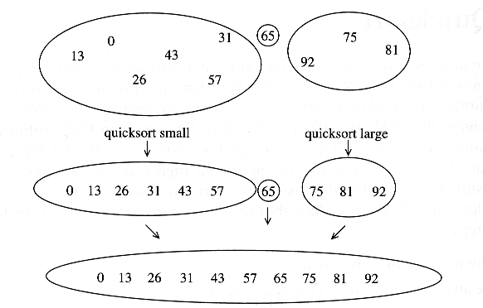
Example of Quick Sort...

Slide 4
Quicksort Algorithm
Input: A[1, …, n]
Output: A[1, .., n], where A[1]<=A[2]…<=A[n]
Quicksort:
  if(n<=1) return;
  Choose the pivot p = A[n]
  Put all elements less than p on the left; put all elements lager than p on the right; put p at the middle. (Partition)
  Quicksort(the array on the left of p)
  Quicksort(the array on the right of p)

Slide 5
Quicksort Algorithm
Quicksort example
Current pivots
Previous pivots
2
8
7
1
3
5
6
4
Quicksort
2
1
3
4
7
5
6
8
2
1
3
4
7
5
6
8
1
2
3
4
5
6
7
8
1
2
3
4
5
6
7
8
1
2
3
4
5
6
7
8

Slide 6
Recursive Algorithm cont…
QUICKSORT(A, p, r)
1. if p < r
2. q =PARTITION(A, p, r)
3. QUICKSORT(A, p, q-1)
4. QUICKSORT(A, q +1, r)
5. Exit

Slide 7
Quicksort Algorithm
Partition example
tail
2
8
7
1
3
5
6
4
tail
2
8
7
1
3
5
6
4
Exchange 2 with A[tail+1]
tail
2
8
7
1
3
5
6
4
Do nothing
tail
2
8
7
1
3
5
6
4
Do nothing

Slide 8
Quicksort Algorithm
Partition example
tail
2
8
7
1
3
5
6
4
Exchange 1 with A[tail+1]
tail
2
1
7
8
3
5
6
4
Exchange 3 with A[tail+1]
tail
2
1
3
8
7
5
6
4
Do nothing
tail
2
1
3
8
7
5
6
4
Do nothing
2
1
3
4
7
5
6
8
Final step: exchange A[n] with A[tail+1]

Slide 9
Recursive Algorithm(partition)
PARTITION(A, p, r)
1. pivot = A[r]
2. tail = p-1
3. for j = p to r – 1
4. if A[j]<=pivot
5. tail=tail+1
6. exchange A[tail]with A[j] [End of If block]
[End of For Loop]
7. exchange A[tail+1] with A[r]
8. return tail + 1

Slide 10
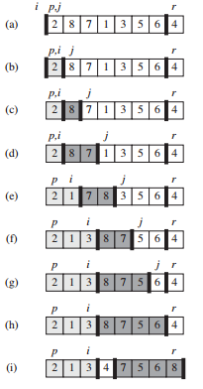
Example:
i=tail

Slide 11
Complexity of Quick sort
Worst case
  O(n²)
Average case
  O(n log n)
Best case
    O(n log n)

Slide 12
#include<iostream>
using namespace std;
int partition(int arr[], int p, int r)
{
int pivot=arr[r];
int tail=p-1;
for(int j=p; j<r;j++)
{
if(arr[j]<=pivot)
{
tail=tail+1;
int temp= arr[j];
arr[j]=arr[tail];
arr[tail]=temp;
}
}
int temp=arr[r];
arr[r]=arr[tail+1];
arr[tail+1]=temp;
return tail+1;
}
void QuickSort(int arr[], int p, int r)
{
if (p < r) {
int q = partition(arr,p,r);
QuickSort(arr, p, q-1);
QuickSort(arr, q + 1, r);
}
}
int main()
{
int arr[] = { 12, 11, 13, 5, 6, 7 };
int arr_size = sizeof(arr) / sizeof(arr[0]);
cout<<"Given array is \n";
for(int i=0;i<arr_size;i++)
cout<<arr[i]<<"\t";
QuickSort(arr, 0, arr_size - 1);
cout<<"\nSorted array is \n";
for(int i=0;i<arr_size;i++)
cout<<arr[i]<<"\t";
return 0;
}

Slide 13
Thank You

